Slide 1

Projects
Dr. Jarret Grout
The Data Incubator
July 14, 2020

Slide 2
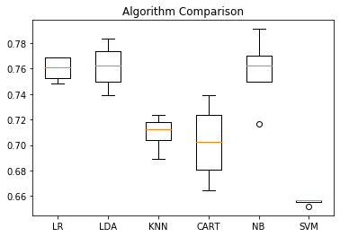
Diabetes prediction
Based on data of the Pima Native Americans, can diabetes be predicted?
Running multiple machine learning algorithms to determine potential benefit
Running a grid search, sequential model for a deep learning calculation, including
  Activation and initialization
  Batch size and epochs
  Learn and dropout rates
  Neuron dimensions
Improvement of accuracy from 73% to 78.3%
(It’s humans => spread)
Provide a baseline that people can measure themselves against
Identify which factors (or combination of factors) is most likely to promote diabetes

Slide 3

Object Detection with OpenCV
There are too many people in the water. This app will return the number in the water and conditions.
Scrape images from internet surfcams
Optical recognition of people and waves
Returns:
  Location name
  Number of people in the water
  Wave presence?
  Chop?
  Optional image
Returns:
Torquay Surf Club: 3WC
Image:https://www.facebook.com/swellnet/photos/a.407681299928/10154497340394929/?type=1&theater

Slide 4
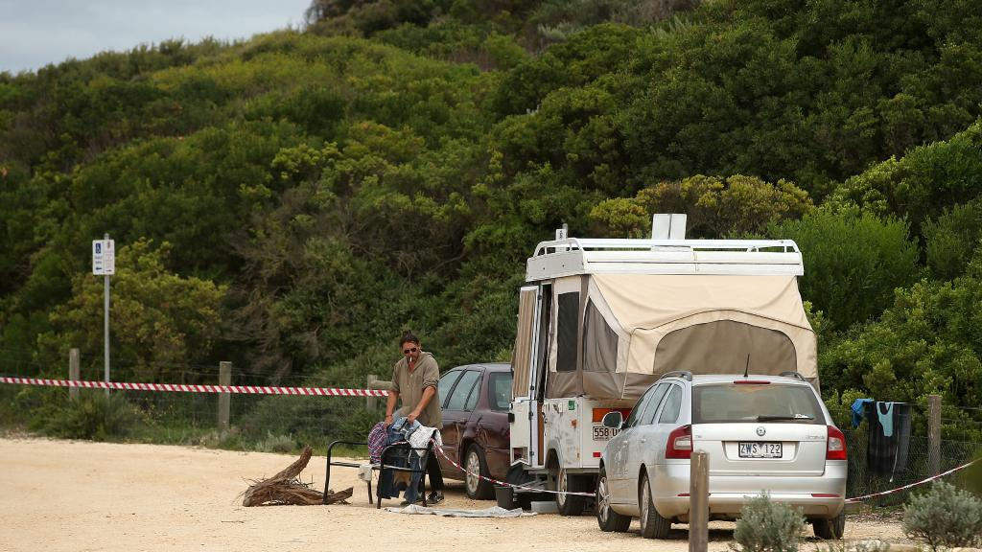

Object Detection with OpenCV
Too many visitors from Melbourne during lockdown. An app to tag people at tourist locations, and help identify tourists.
Images taken by citizens
Optical recognition of license plates, GPS location, time, date
Uploads:
  License plate number
  Confidence (<95% = fail)
  Location
  Time
  Date
  Photographer identifier
  Compressed image
Analysed for plates from lockdown regions
Uploads: ZWS122
0.96
Latitude:38° 18.451’ S
144° 22.584' E
11:00
2020:05:02
123456789
Compressed Image
Image: https://cdn.newsapi.com.au/image/v1/e88922d2ba0b270abd02c7f548155d33?width=1024

Slide 5
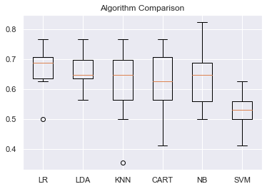
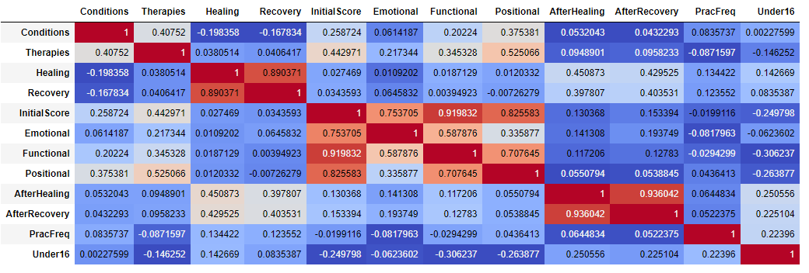
Neuroplasticity for Vertigo / Tinnitus Healing
Can the ability to heal vertigo and tinnitus with neuroplasticity be predicted?
What factors contribute to a higher likelihood of healing?
What factors prevent healing?
Where can improvements in the delivery of the program be realized?
Can programs be tailored to the specific needs of participants?
Significant room for growth in this now million dollar company

